Slide 1


ScrapeVerse by Compile Crew
This project demonstrates the power of web scraping and analysis by collecting financial information from Yahoo Finance and presenting it in a user-friendly web interface
By
Tarun Lagadapati
Sudhish Cherukuri
Krishna Teja Rayapudi
Saivenkat Chinta
Jashmitha Daggupati

Slide 2
What is Go?
Programming Paradigm
Historical Evolution
Key Improvements
Statically typed, compiled language for simplicity and efficiency.
Created at Google in 2007, released in 2009.
Addresses C/C++ issues like dependency management and concurrency.

Slide 3

Key Features of Go
1
Concurrency
2
Tooling
Goroutines and channels for efficient parallel task management.
Built-in tools for testing, formatting, and building.
3
Simplicity
4
Performance
Minimal syntax enhances developer productivity.
Highly efficient for backend systems and deployments.

Slide 4




Why Go for ScrapeVerse?
Efficiency
Concurrency model ideal for web scraping stock websites.
Ease of Use
Simple syntax for rapid API and scraping logic.
Reliability
Strong type system ensures fewer runtime errors.

Slide 5
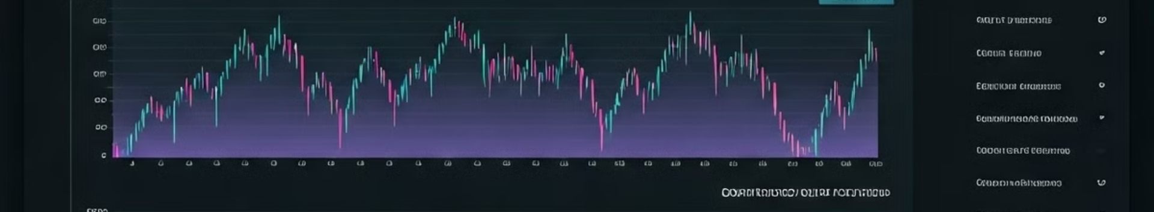




ScrapeVerse Features
Scraping
Analysis
Exporting
Interactive API
Collects real-time stock data from Yahoo Finance.
Identifies top gainers/losers, sorts data by price and search for a stock.
Allows downloading data in CSV format.
Built with Gin framework for smooth HTTP handling.

Slide 6



Challenges and Solutions
Challenge
Solution
Managing multiple web requests
Utilized Go's goroutines for concurrent processing
Preventing duplicate data scraping
Implemented scraping status flag
Handling dynamic data changes
Used HTML attribute selectors for precise extraction
Parsing irregular data formats
Added error handling to clean and parse data

Slide 7
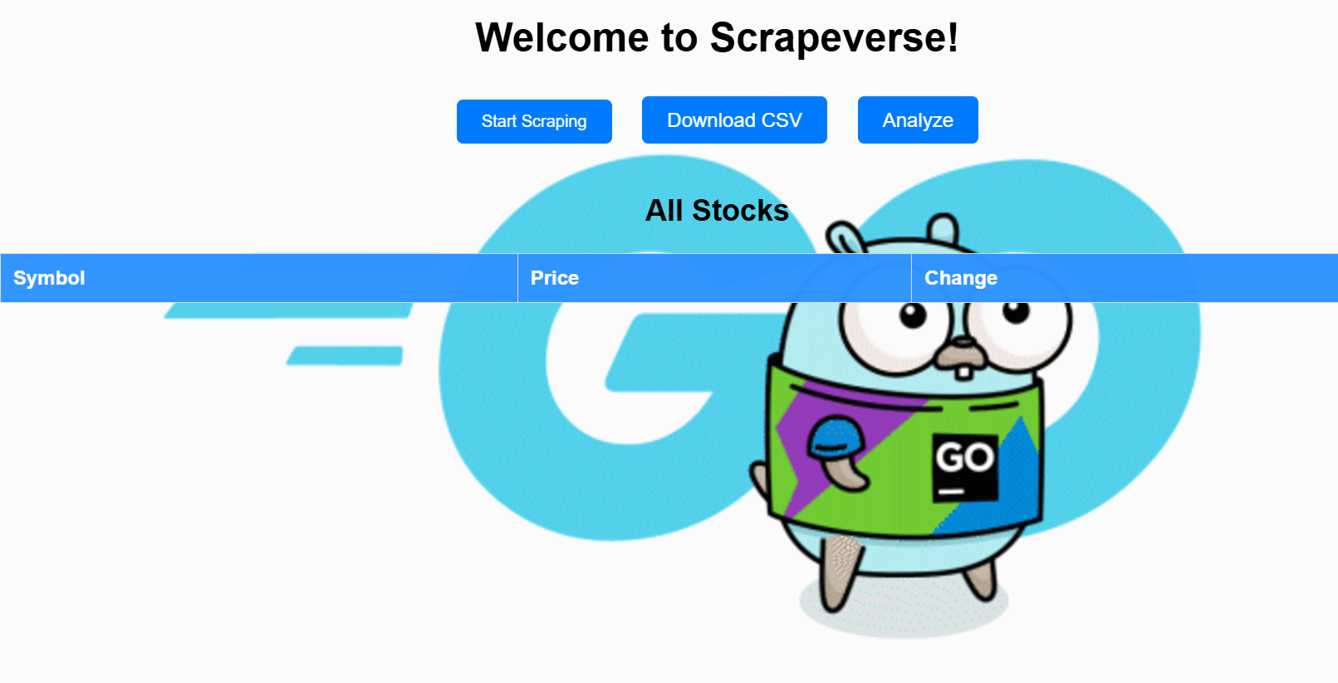
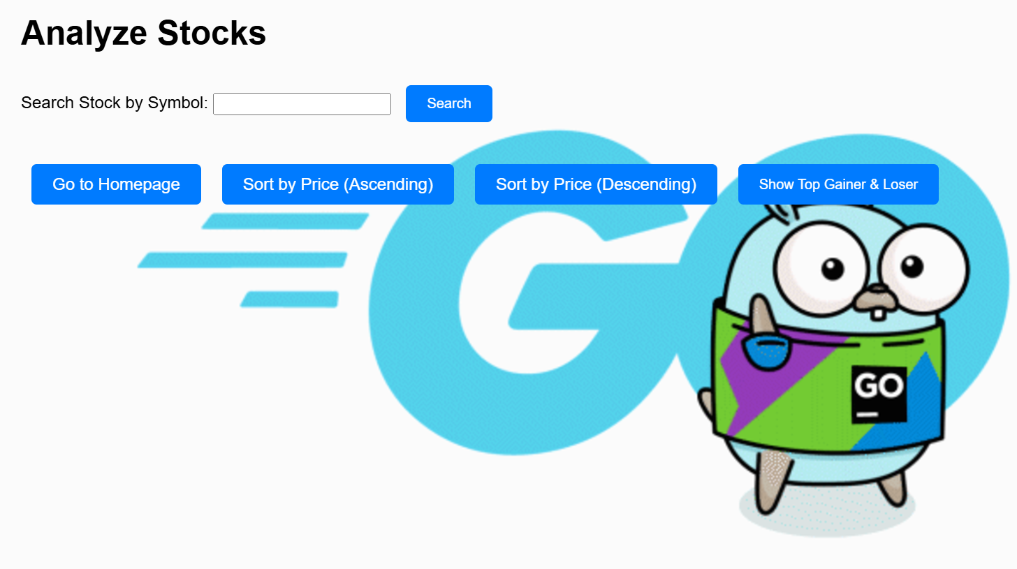

Project Demonstration
Home Page
Analyze Page
Export Feature
Displays API endpoints and features.
Shows stock analysis results with interactive elements.
Demonstrates CSV export functionality with data preview.

Slide 8
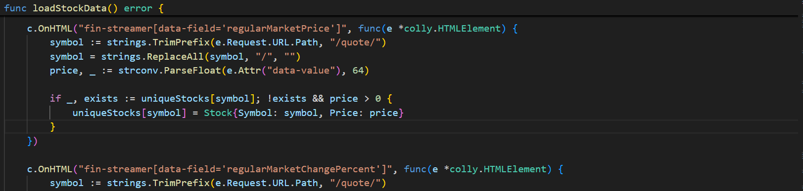
Sample Code Highlight
Scraping Logic
Concurrency
Data Export
Colly library for efficient website parsing.
Goroutines handle multiple stock symbols simultaneously.
CSV writer enables easy download of stock data.

Slide 9
Team Contributions
Krishna Teja Rayapudi
1
Developed web scraper using Colly.
2
Tarun Lagadapati
Implemented data storage and organization.
Sudhish Cherukuri
3
Designed APIs for data handling and sorting.
4
Saivenkat Chinta
Set up project environment and Gin framework.
Jashmitha Daggupati
5
Tested API endpoints and handled debugging.

Slide 10

Conclusion
1
Summary
2
Future Improvements
ScrapeVerse demonstrates Go's efficiency for scalable web scraping.
Add historical data analysis and enhance frontend interactivity.
3
Final Thoughts
Go excels in concurrent and backend development projects.

